Slide 1
Composite materials Wessam Al Azzawi
Lecture 3: Matrix
The roles of the matrix in a fiber -reinforced composite are:
To keep the fibers in place
To transfer stresses between the fibers
To provide a barrier against an adverse environment, such as chemicals and moisture
To protect the surface of the fibers from mechanical degradation
The matrix plays a minor role in the tensile load -carrying capacity
Has a major influence on the compressive and in-plane shear properties
The matrix provides lateral support against the possibility of fiber buckling under compressive loading

Slide 2
Composite materials Wessam Al Azzawi
Lecture 3: Matrix
Types of matrix
Table 1 lists various matrix materials that have been used either commercially or in research.
Among these, thermoset polymers, such as epoxies, polyesters, and vinyl esters, are more commonly used as matrix material in continuous or long fiber reinforced composites because of the ease of processing due to their low viscosity.
Thermoplastic polymers are more commonly used with short fiber reinforced composites that are injection molded; however, the interest in continuous fiber reinforced thermoplastic matrix is growing.
Metallic and ceramic matrices are primarily considered for high temperature applications. We briefly discuss these three categories of matrix in this section.

Slide 3
Composite materials Wessam Al Azzawi
TABLE 1
Matrix Materials
POLYMERIC
Thermoset polymers
Epoxies: principally used in aerospace and aircraft applications
Polyesters, vinyl esters: commonly used in automotive, marine, chemical, and electrical applications
Phenolics: used in bulk molding compounds
Polyimides, polybenzimidazoles (PBI), polyphenylquinoxaline (PPQ): for high-temperature
aerospace applications (temperature range: 2508C–4008C)
Cyanate ester
Thermoplastic polymers
Nylons (such as nylon 6, nylon 6,6), thermoplastic polyesters (such as PET, PBT),
polycarbonate (PC), polyacetals: used with discontinuous fibers in injection-molded
articles
Polyamide-imide (PAI), polyether ether ketone (PEEK), polysulfone (PSUL), polyphenylene
sulfide (PPS), polyetherimide (PEI): suitable for moderately high temperature applications
with continuous fibers
METALLIC
Aluminum and its alloys, titanium alloys, magnesium alloys, copper-based alloys, nickel-based superalloys, stainless steel: suitable for high-temperature applications (temperature range: 3008C–5008C)
CERAMIC
Aluminum oxide (Al2O3), carbon, silicon carbide (SiC), silicon nitride (Si3N4): suitable for high-temperature applications

Slide 4
Composite materials Wessam Al Azzawi
Lecture 3: Matrix
The most common advanced composites are polymer matrix composites (PMCs) consisting of a polymer (e.g., epoxy, polyester, urethane). The reasons why they are the most common composites include:
Their low cost
Low weight
The simple manufacturing principles
Low thermal and electrical conductivity
Absorb vibration
However, the main drawback of polymers composites are:
low operating temperatures
High coefficients of thermal and moisture expansion
low mechanical properties

Slide 5
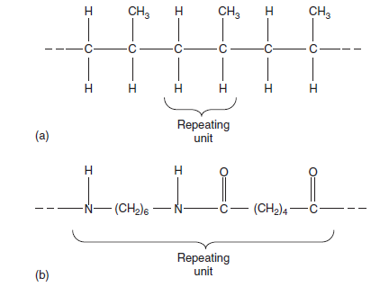
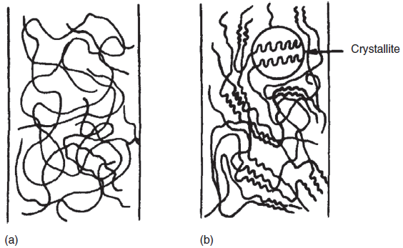
Composite materials Wessam Al Azzawi
Lecture 3: Matrix
Polymer matrix
A polymer is defined as a long-chain molecule containing one or more repeating units of atoms (Fig.1) joined together by strong covalent bonds.
A polymeric material (called a plastic) is a collection of a large number of polymer molecules of similar chemical structure (but not of equal length).
In the solid state, these molecules are frozen in space, either in a random fashion in amorphous polymers or in a mixture of random fashion and orderly fashion (folded chains) in semicrystalline polymers (Fig.2). However, on a submicroscopic scale, various segments in a polymer molecule may be in a state of random excitation. The frequency, intensity, and number of these segmental motions increase with increasing temperature, giving rise to the temperature dependent properties of a polymeric solid.
Fig.1
Fig.2 (a) amorphous polymers and (b) semicrystalline polymers

Slide 6
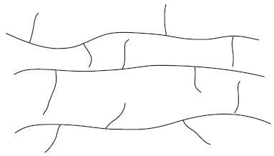
Composite materials Wessam Al Azzawi
Lecture 3: Matrix
Thermoplastic and Thermoset Polymers:
Polymers are divided into two broad categories: thermoplastics and thermosets. In a thermoplastic polymer, individual molecules are not chemically joined together (Fig.a). They are held in place by weak secondary bonds or intermolecular forces, such as van der Waals bonds and hydrogen bonds. With the application of heat, these secondary bonds in a solid thermoplastic polymer can be temporarily broken and the molecules can now be moved relative to each other or flow to a new configuration if pressure is applied on them. On cooling, the molecules can be frozen in their new configuration and the secondary bonds are restored, resulting in a new solid shape. Thus, a thermoplastic polymer can be heat-softened, melted, and reshaped (or postformed) as many times as desired.

Slide 7
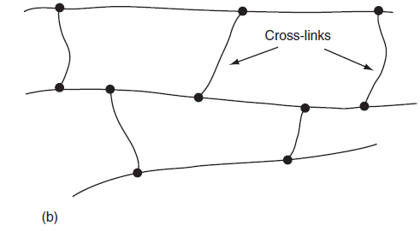
Composite materials Wessam Al Azzawi
Lecture 3: Matrix
In a thermoset polymer, on the other hand, the molecules are chemically joined together by cross-links, forming a rigid, three-dimensional network structure (Fig.b). Once these cross-links are formed during the polymerization reaction (also called the curing reaction), the thermoset polymer cannot be melted by the application of heat. However, if the number of crosslinks is low, it may still be possible to soften them at elevated temperatures.

Slide 8
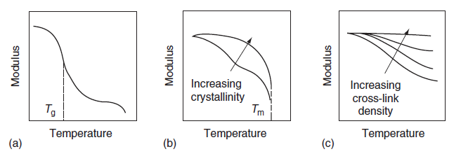
Composite materials Wessam Al Azzawi
Lecture 3: Matrix
Unique Characteristics of Polymers:
There are two unique characteristics of polymeric solids that are not observed in metals under ordinary conditions, namely, that their mechanical properties depend strongly on both the ambient temperature and the loading rate. Fig.3 schematically shows the general trends in the variation of tensile modulus of various types of polymers with temperature. Near the glass transition temperature, denoted by Tg in this diagram, the polymeric solid changes from a hard, sometimes brittle (glass-like) material to a soft, tough (leather-like) material. Over a temperature range around Tg, its modulus is reduced by as much as five orders of magnitude.
Fig.3 Variation of tensile modulus with temperature for three different types of polymers: (a) amorphous thermoplastic, (b) semicrystalline thermoplastic, and (c) thermoset

Slide 9
Composite materials Wessam Al Azzawi
Lecture 3: Matrix
Near this temperature, the material is also highly viscoelastic. Thus, when an external load is applied, it exhibits an elastic deformation followed by a slow viscous deformation. With increasing temperature, the polymer changes into a rubber-like solid capable of undergoing large , elastic deformations under extern al loads.
However, for a thermoset polymer, no melting occurs; instead, it chars and finally burns at very high temperatures. The glass transition temperature of a thermoset polymer can be controlled by varying the amount of cross-linking between the molecules. For very highly cross- linked polymers, the glass transition and the accompanying softening may not be observed.

Slide 10
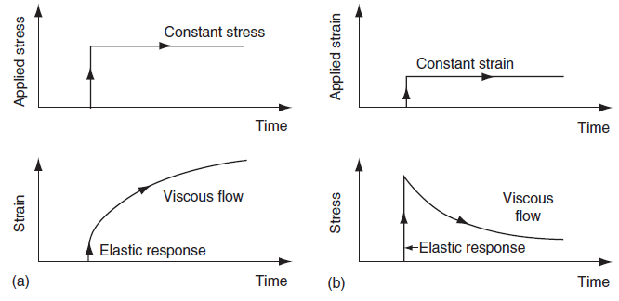
Composite materials Wessam Al Azzawi
Lecture 3: Matrix
Creep and Stress Relaxation
The viscoelastic characteristic of a polymeric solid is best demonstrated by creep and stress relaxation tests. In creep tests, a constant stress is maintained on a specimen while its deformation (or strain) is monitored as a function to time. As the polymer creeps, the strain increases with time. In stress relaxation tests, a constant deformation (strain) is maintained while the stress on the specimen is monitored as a function of time. In stress relaxation, stress decreases with time. Both tests are performed at various ambient temperatures of interest . Typical creep and stress relaxation diagrams, shown schematically in Fig.4, exhibit an instantaneous elastic response followed by a delayed viscous response. In general, thermoset polymers exhibit lower creep and stress relaxation than thermoplastic polymers.

Slide 11
Composite materials Wessam Al Azzawi
Lecture 3: Matrix
Selection of Matrix: Thermosets vs. Thermoplastics
The primary consideration in the selection of a matrix is its basic mechanical properties. For high-performance composites, the most desirable mechanical properties of a matrix are
High tensile modulus, which influences the compressive strength of the composite
High tensile strength, which controls the intraply cracking in a composite laminate
High fracture toughness, which controls ply delamination and crack growth
For a polymer matrix composite, there may be other considerations, such as good dimensional stability at elevated temperatures and resistance to moisture or solvents. The former usually means that the polymer must have a high glass transition temperature Tg. In practice, the glass transition temperature should be higher than the maximum use temperature. Resistance to moisture and solvent means that the polymer should not dissolve, swell, crack (craze), or otherwise degrade in hot–wet environments or when exposed to solvents. Some common solvents in aircraft applications are jet fuels, deicing fluids, and paint strippers. Similarly, gasoline, motor oil, and antifreeze are common solvents in the automotive environment.

Slide 12
Composite materials Wessam Al Azzawi
Lecture 3: Matrix
Selection of Matrix: Thermosets vs. Thermoplastics
Traditionally, thermoset polymers (also called resins) have been used as a matrix material for fiber-reinforced composites. The starting materials used in the polymerization of a thermoset polymer are usually low-molecular-weight liquid chemicals with very low viscosities. Fibers are either pulled through or immersed in these chemicals before the polymerization reaction begins. Since the viscosity of the polymer at the time of fiber incorporation is very low, it is possible to achieve a good wet-out between the fibers and the matrix without the aid of either high temperature or pressure. Fiber surface wetting is extremely important in achieving fiber–matrix interaction in the composite, an essential requirement for good mechanical performance. Among other advantages of using thermoset polymers are their thermal stability and chemical resistance. They also exhibit much less creep and stress relaxation than thermoplastic polymers.

Slide 13
Composite materials Wessam Al Azzawi
Lecture 3: Matrix
Selection of Matrix: Thermosets vs. Thermoplastics
The disadvantages of thermosets are:
Limited storage life (before the final shape is molded) at room temperature
Long fabrication time in the mold (where the polymerization reaction, called the curing reaction or simply called curing , is carried out to transform the liquid polymer to a solid polymer)
Low strain-to-failure which also contributes to low impact strengths
The most important advantage of thermoplastic polymers over thermoset polymers is their high impact strength and fracture resistance, which in turn impart an excellent damage tolerance characteristic to the composite material. In general, thermoplastic polymers have higher strain-to-failure than thermoset polymers, which may provide a better resistance to matrix micro cracking in the composite laminate.

Slide 14
Composite materials Wessam Al Azzawi
Lecture 3: Matrix
Selection of Matrix: Thermosets vs. Thermoplastics
Other advantages of thermoplastic polymers are:
Unlimited storage (shelf) life at room temperature
Shorter fabrication time
Post formability (e.g., by thermoforming)
Ease of joining and repair by welding, solvent bonding, and so on
Ease of handling (no tackiness)
Can be reprocessed and recycled

Slide 15
Composite materials Wessam Al Azzawi
Lecture 3: Matrix
Selection of Matrix: Thermosets vs. Thermoplastics
In spite of such distinct advantages, the development of continuous fiber reinforced thermoplastic matrix composites has been much slower than that of continuous fiber-reinforced thermoset matrix composites. Because of their high melt or solution viscosities, incorporation of continuous fibers into a thermoplastic matrix is difficult. Commercial engineering thermoplastic polymers, such as nylons and polycarbonate, are of very limited interest in structural applications because they exhibit lower creep resistance and lower thermal stability than thermoset polymers. Recently, a number of thermoplastic polymers have been developed that possess high heat resistance and they
are of interest in aerospace applications.

Slide 16
Composite materials Wessam Al Azzawi
Lecture 3: Matrix
Metal Matrix
Metal matrix has the advantage over polymeric matrix in applications requiring a long-term resistance to severe environments, such as high temperature. The yield strength and modulus of most metals are higher than those for polymers, and this is an important consideration for applications requiring high transverse strength and modulus as well as compressive strength for the composite. Another advantage of using metals is that they can be plastically deformed and strengthened by a variety of thermal and mechanical treatments.
However, metals have a number of disadvantages, namely, they have high densities, high melting points (therefore, high process temperatures), and a tendency toward corrosion at the fiber–matrix interface.

Slide 17
Composite materials Wessam Al Azzawi
Lecture 3: Matrix
The two most commonly used metal matrices are based on aluminum and titanium. Both of these metals have comparatively low densities and are available in a variety of alloy forms. Although magnesium is even lighter, its great affinity toward oxygen promotes atmospheric corrosion and makes it less suitable for many applications. Beryllium is the lightest of all structural metals and has a tensile modulus higher than that of steel. However, it suffers from extreme brittleness, which is the reason for its exclusion as a potential matrix material. Nickel- and cobalt-based superalloys have also been used as matrix; however, the alloying elements in these materials tend to accentuate the oxidation of fibers at elevated temperatures.

Slide 18
Composite materials Wessam Al Azzawi
Lecture 3: Matrix
Aluminum and its alloys have attracted the most attention as matrix material in metal matrix composites. Commercially, pure aluminum has been used for its good corrosion resistance. Aluminum alloys, such as 201, 6061, and 1100, have been used for their higher tensile strength–weight ratios. Carbon fiber is used with aluminum alloys; however, at typical fabrication temperatures of 5008C or higher, carbon reacts with aluminum to form aluminum carbide (Al4C3), which severely degrades the mechanical properties of the composite. Protective coatings of either titanium boride (TiB2) or sodium has been used on carbon fibers to reduce the problem of fiber degradation as well as to improve their wetting with the aluminum alloy matrix. Carbon fiber-reinforced aluminum composites are inherently prone to galvanic corrosion, in which carbon fibers act as a cathode owing to a corrosion potential of 1 V higher than that of aluminum. A more common reinforcement for aluminum alloys is SiC.

